Slide 1
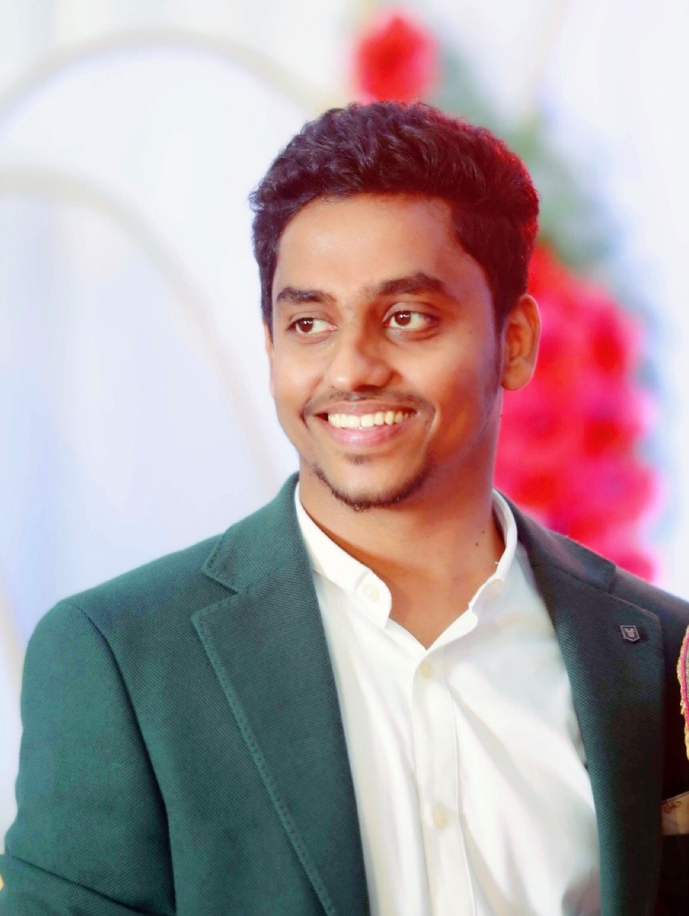
Hello!
I am Prabhu Thangavel (aka) Vijay
I am here because I love to empower people with new skillsets.
I have 8+ years of industry exposure.
Also worked in various state-of-art technologies across my carrier.

